Slide 1
iPhone
The phone that shaped modern technology

Slide 2
What?
First full screen candy-bar style smartphone
Origin of “sleek” design
1st Generation iPhone

Slide 3
Why?
“less is more” design
Favored ease of use over functionality
Break the mold of Blackberry-like smartphones

Slide 4
When?
Announced on June 11th, 2007
Released on June 29th, 2009
Took over smartphone industry

Slide 5
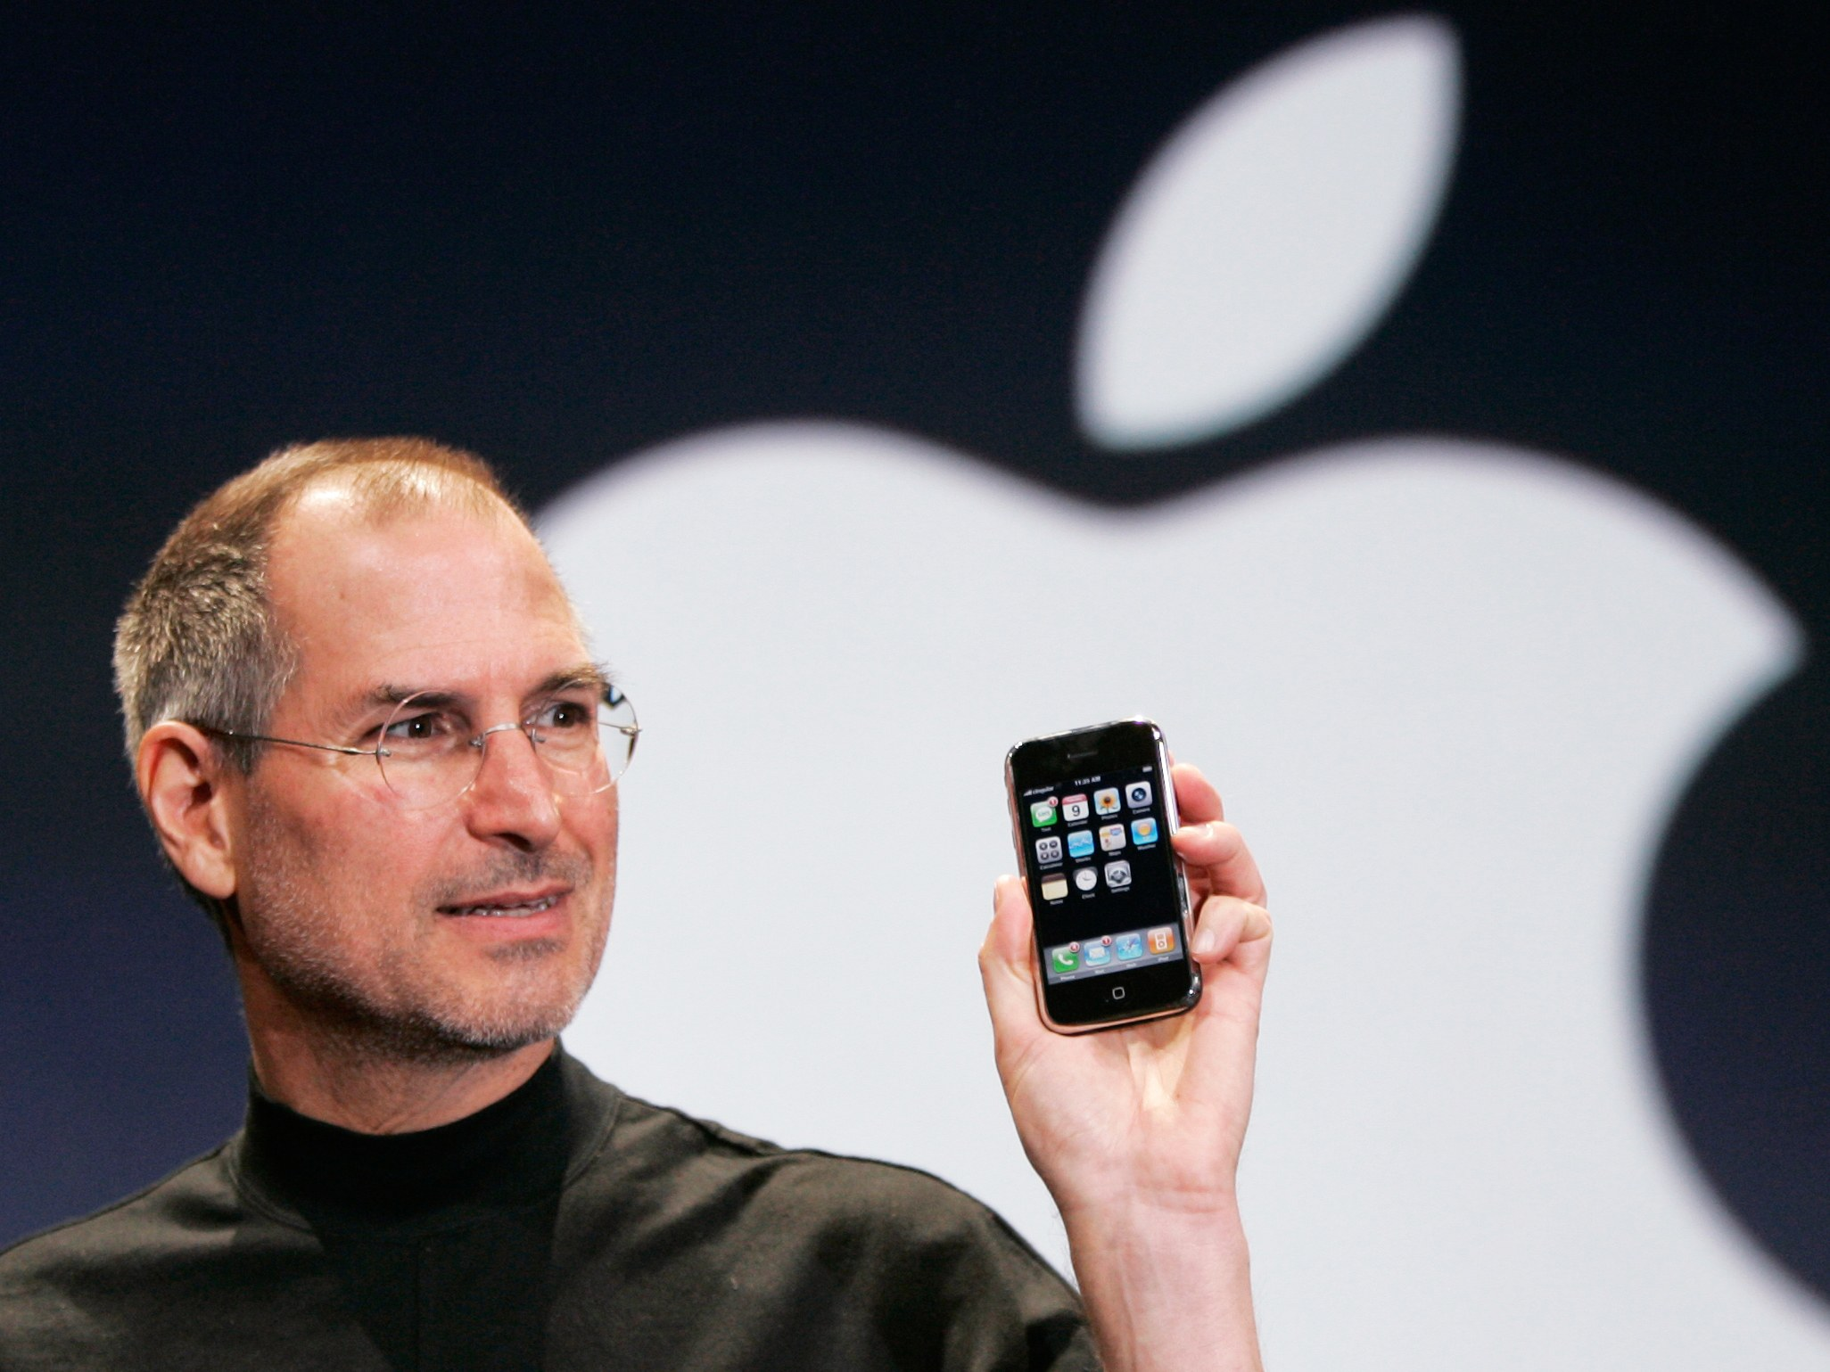
Who?
Steve Jobs
CEO and co-founder of Apple
Jony Ive
Chief Design Officer of Apple
Left Apple to start independent design company in 2019

Slide 6
Where?
Apple Campus,
Cupertino, California

Slide 7
How?
Removed hardcase keyboard
First full-width touchscreen smartphone
Easy-to-use interface

Slide 8
¡Thanks for Watching!
Presentation by:
Renne Venico

