Slide 1
The Refrigerator
Emily Chopoorian

Slide 2
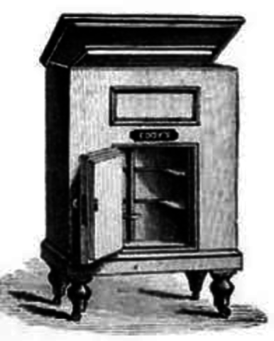
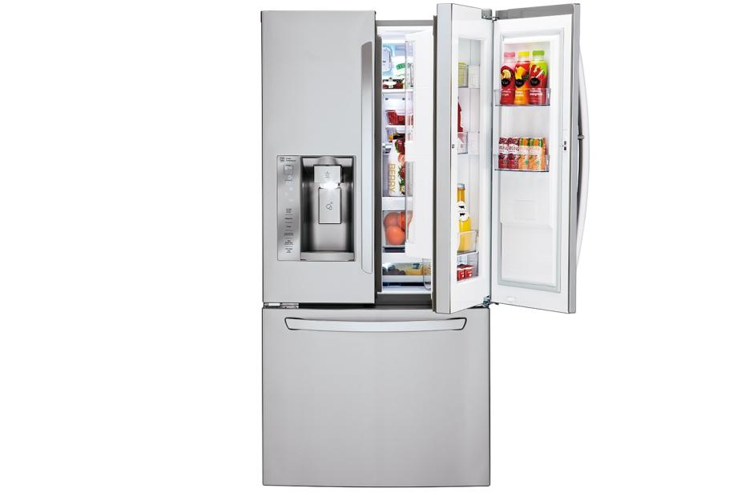
WHAT?

Slide 3
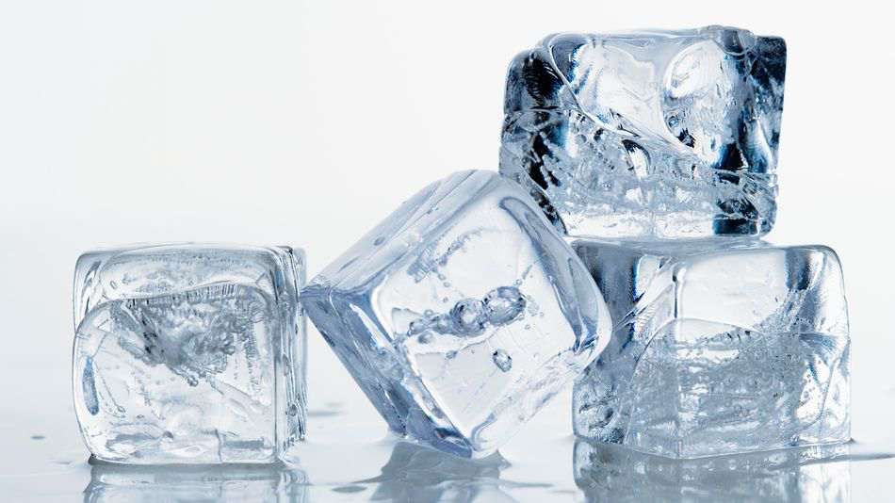
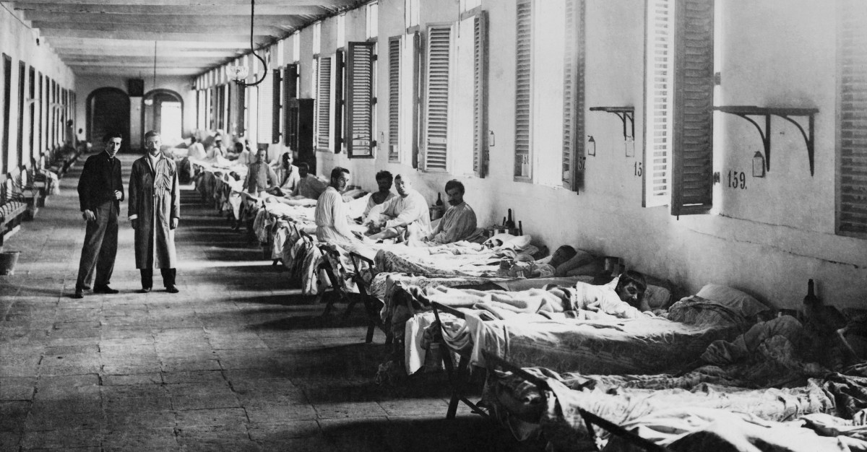
WHY?
Ice Making
Yellow Fever
Notes:
The refrigerator was first created to make ice during warm seasons and keep it cold.
Then this first design was improved upon in order for a doctor to make ice to treat his yellow fever patients

Slide 4
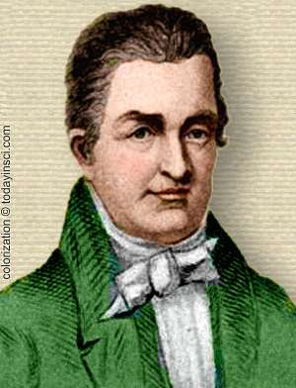
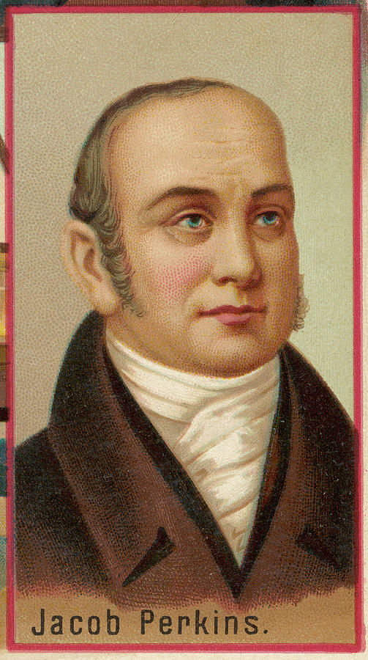
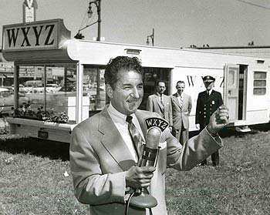
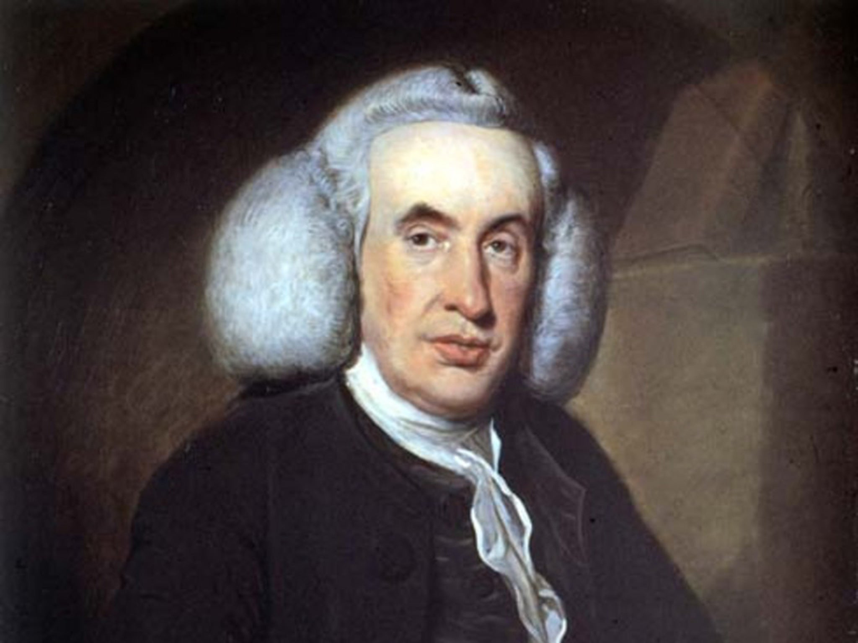
WHEN? WHO?
1748
1805
1834
1913
William Cullen
Oliver Evans
Jacob Perkins
Fred W. Wolf
Created first known artificial refrigeration at University of Glasgow
Created the first refrigeration machine
First practical refrigerator
First refrigerator meant for home use

Slide 5
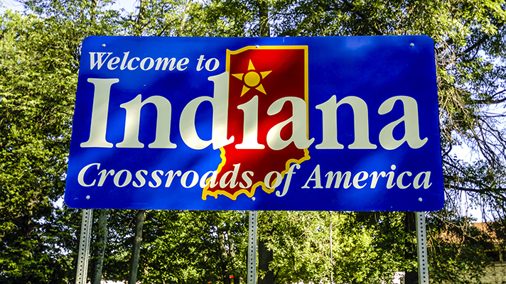
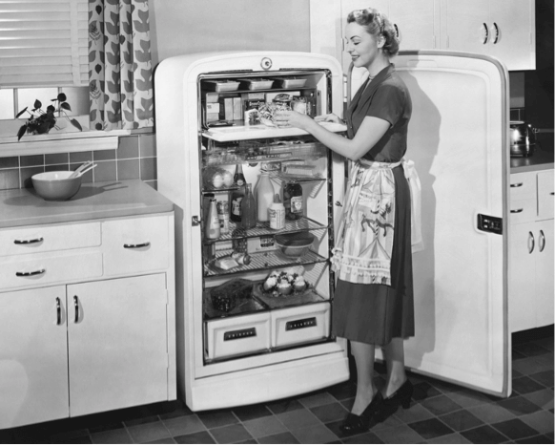
WHERE?
Notes:
The first refrigerator was sold for home use was in indiana

Slide 6
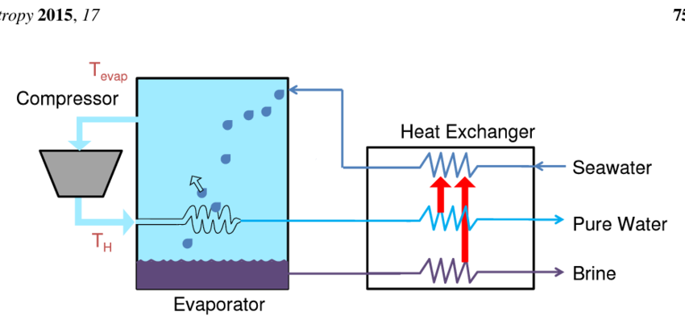
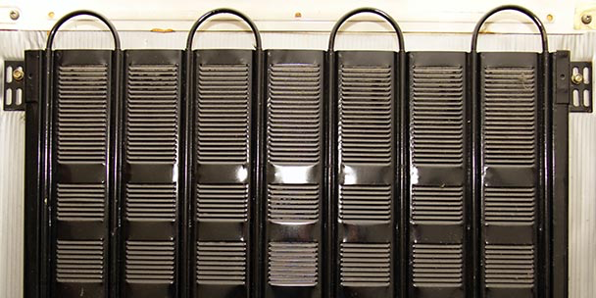
HOW?
Vapor compressor
Refrigerator Coil

