Slide 1
Post-it notes
By: Carly Binday

Slide 2
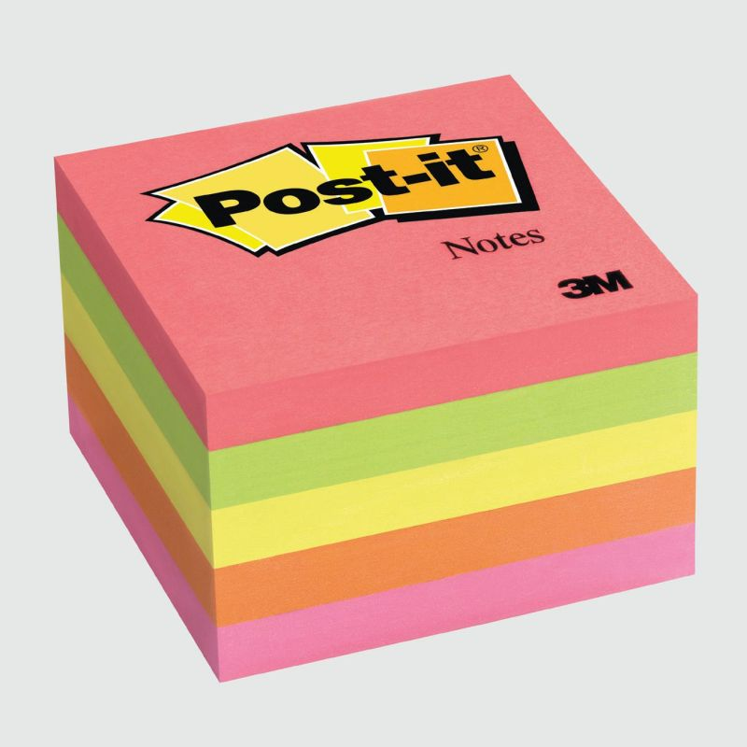
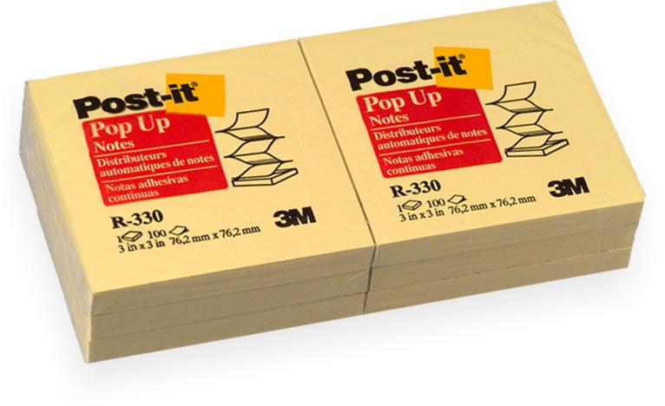
What?

Slide 3
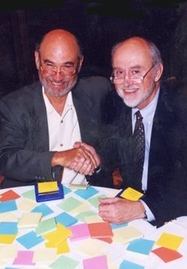
Who?
Spencer Silver
Arthur Fry

Slide 4
When?/ How?
1968- Spencer Silver developed an adhesive with a “removability characteristic” that would allow attached surfaces to be easily peeled apart
1974- Silver was approached by Arthur Fry (his colleague) about an idea that would put his adhesive to use
1980- product released to the market
The product spread “like a virus” because of the way customers shared notes with others, thus sparking the interest of recipients

Slide 5
Why?
Fry complained that in his church choir book, he would bookmark pages with paper but they would easily fall out
wanted a bookmark to stick to the papers without damaging them

Slide 6
Where?
Invented at The 3M Company
Silver and Fry worked at 3M
Launch in Boise, Idaho
Currently available in over 100 countries

