Slide 1
The High Heel
By Lindsey Knutzen

Slide 2
What?

Slide 3
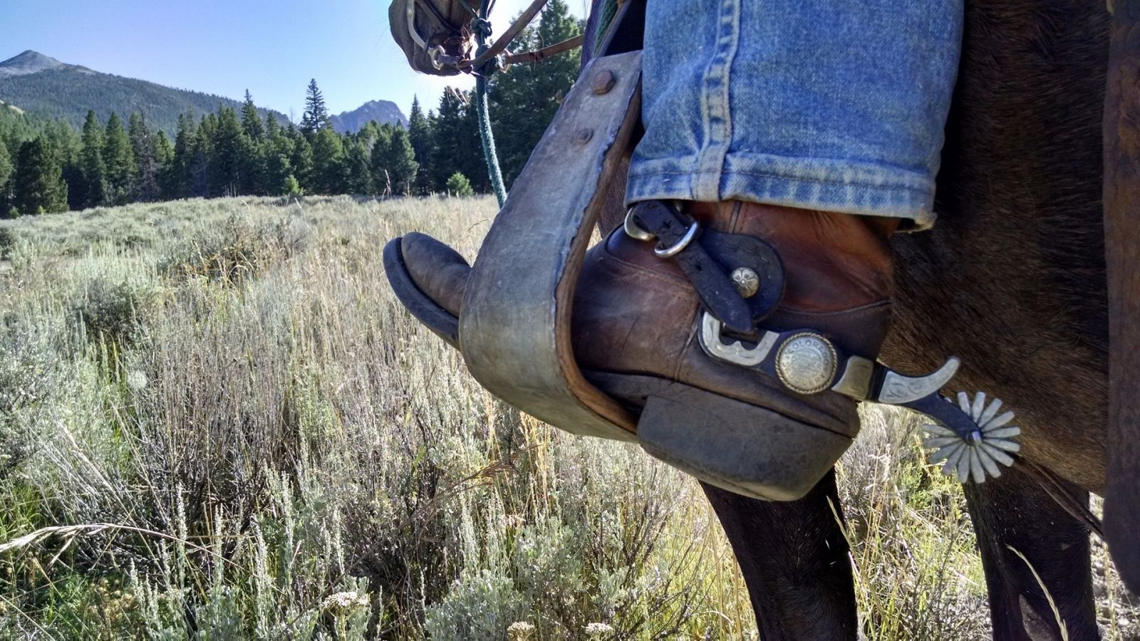
Why?
Started with cowboys to keep their heels in the stirrups
Men wore the first heeled shoes!
Became a symbol of upper class
Women started wearing shoes to make their feet appear smaller
Nothing to do with lengthening the leg

Slide 4
When?
Cowboys were wearing the heels in the 10th century
Came into women’s fashion in the 18th century
Brought to Europe from Persia

Slide 5
How?
Made in 3 separate parts
The sole, upper, and heel
Mass production is largely done by machine with quality control workers

Slide 6
Where?
Started in Persia
Moved through the rest of Europe
Eventually spread throughout the world

Slide 7
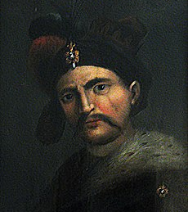
Who?
Shāh Abbās the Great
5th king of Iran
First to wear them to make himself appear taller

