Slide 1
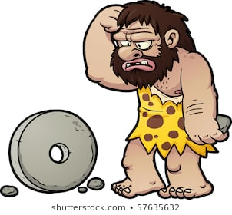
The Wheel
By: Zack Yoelson

Slide 2
Who?
The Sumerians
The Ancient Greeks
John Boyd Dunlop (rubber tires)

Slide 3
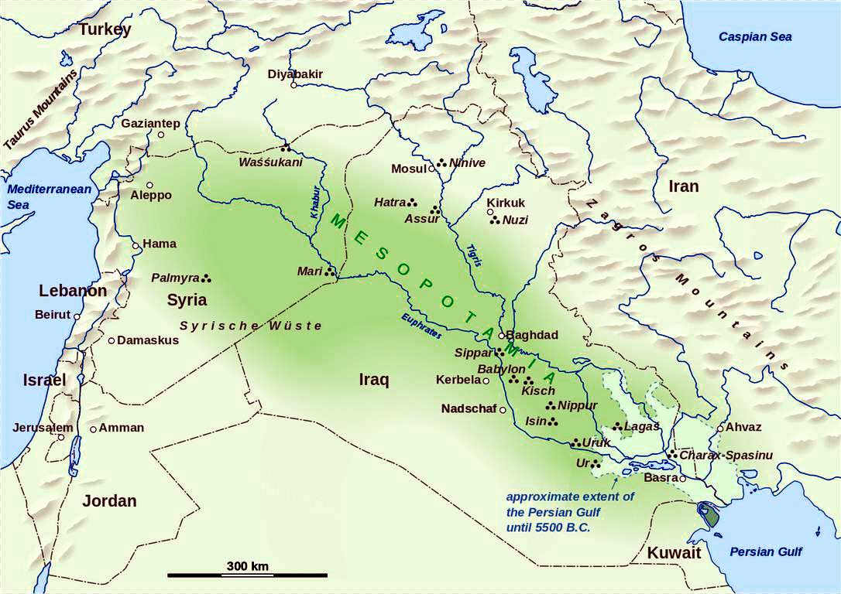
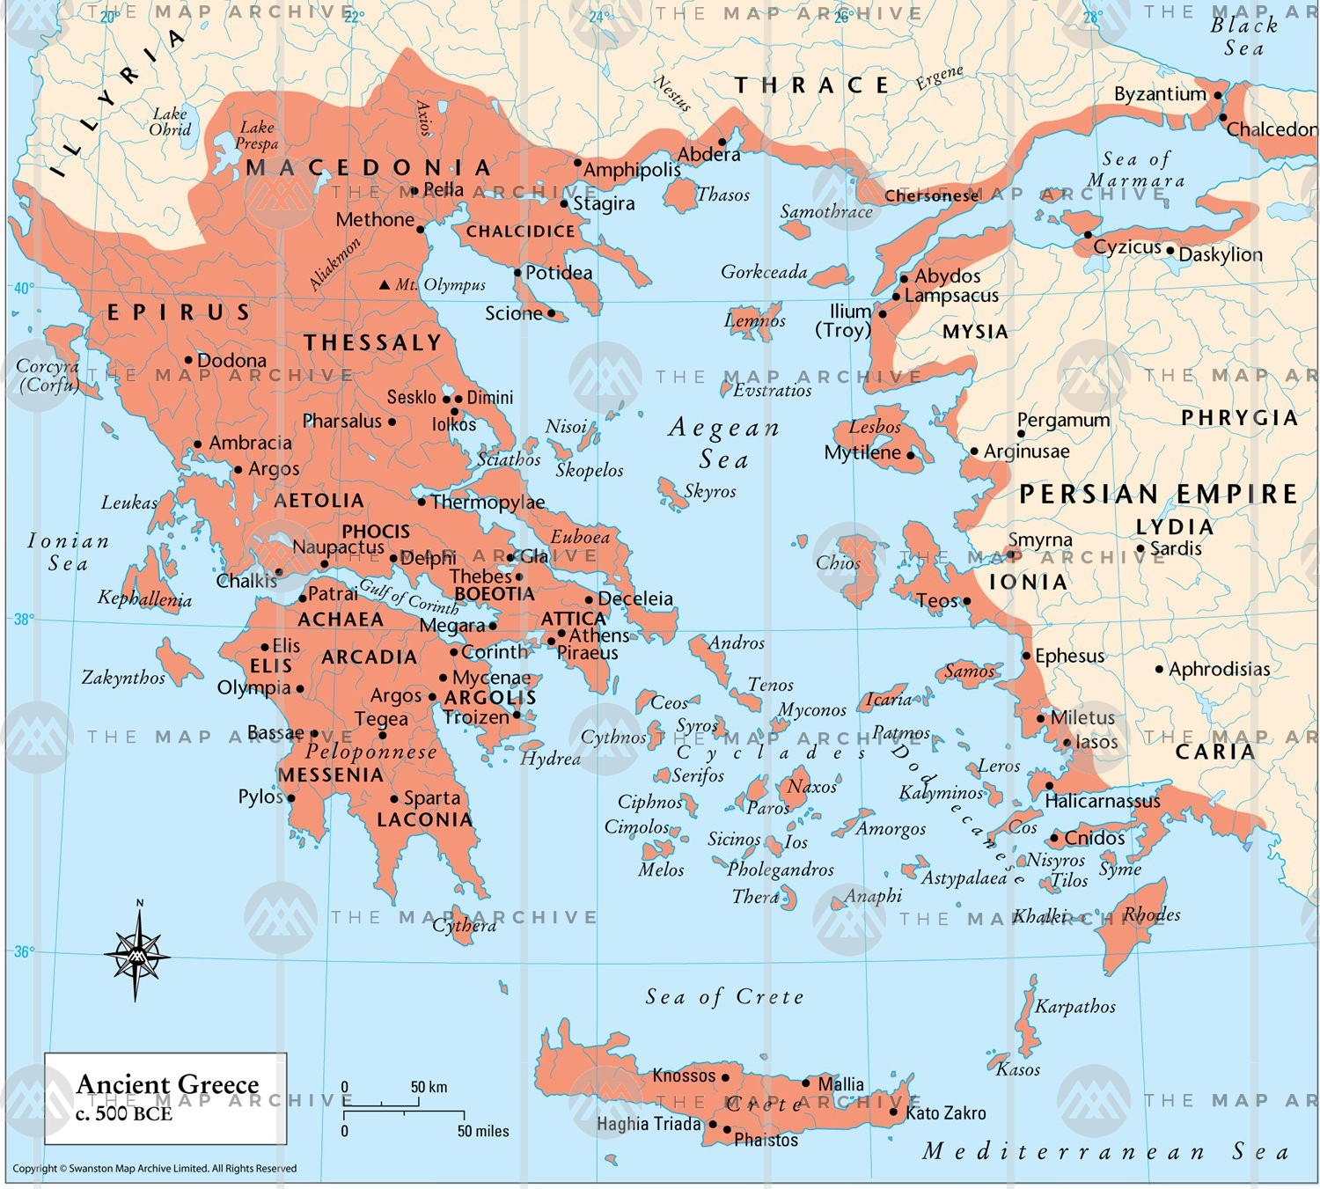
Where?
1086 × 768
Sumer
Ancient Greece
Belfast, Northern Ireland

Slide 4
When?
Ancient Sumerians: ~5,500 years ago
Ancient Greeks: ~3,500 years ago
John Boyd Dunlop: 133 years ago

Slide 5
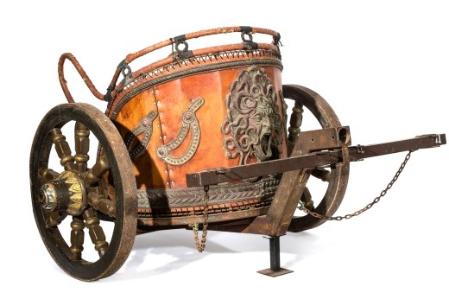
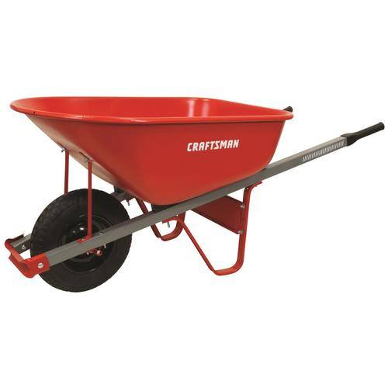
Why?
500 × 500
Sumerians created the wheel as a tool for creating pottery
The Greeks greatly improved its design and applied it to agriculture (wheelbarrow)
Dunlop wanted to make a perfect tire for bicycle races

Slide 6
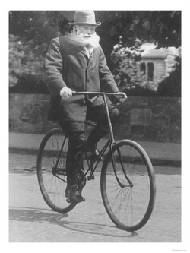
How?
A Sumerian cut down a tree and took out a flat slice of the trunk
That slice was then used as a surface to create pottery
Dunlop (who was experienced with rubber) took a metal wheel and put rubber on it
It rolled so well he put them on both tires

Slide 7
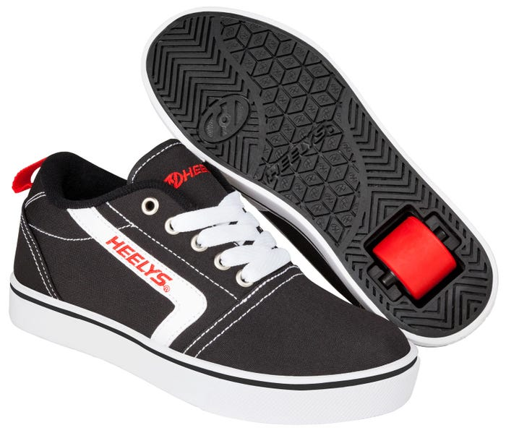
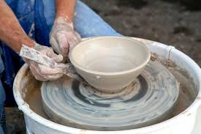
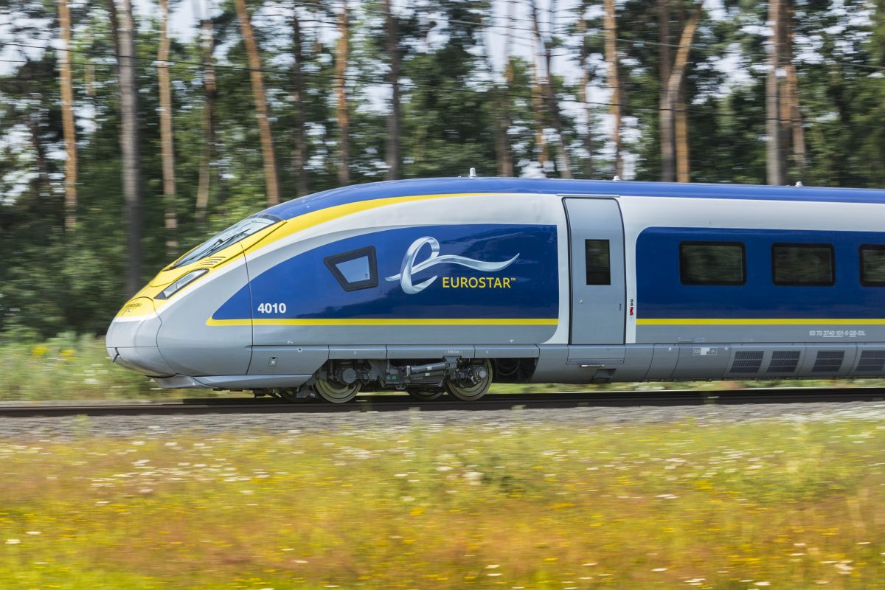
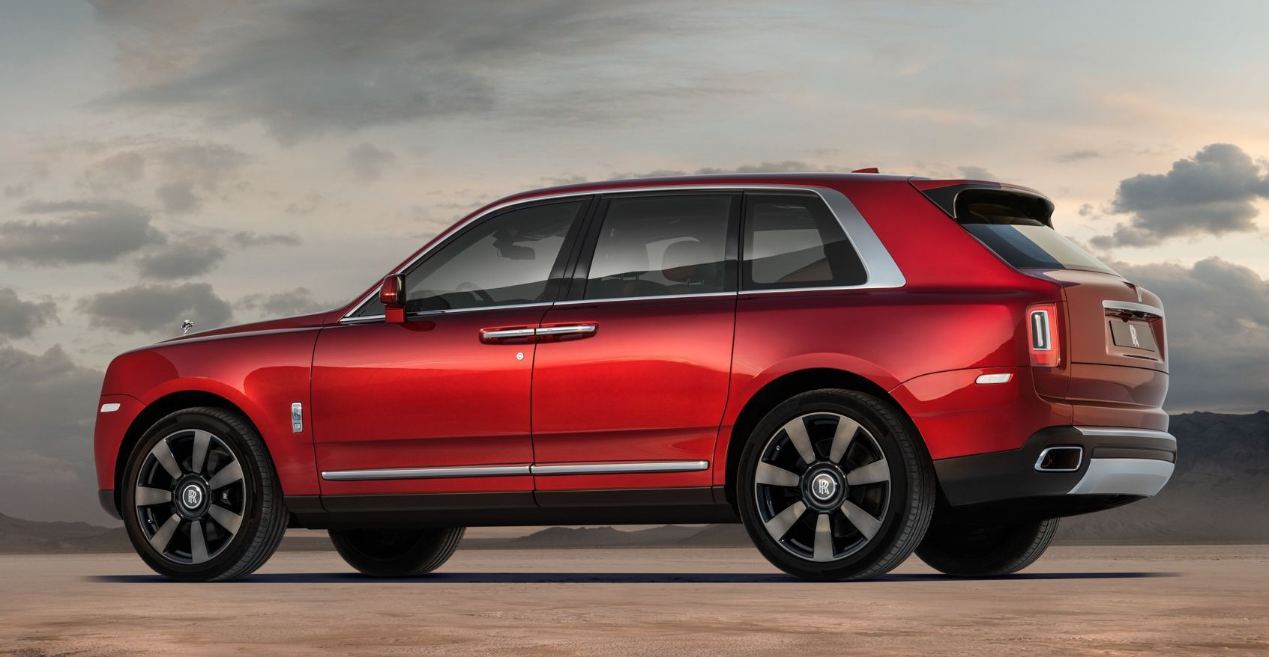
What?
1000 × 667
roudenbush

